Slide 1
ITSS SOFTWARE ENGINEERING

Slide 2
Table of contents
01
02
03
04
05
Overall Description
System Architecture and Architecture Design
Introduction
Detailed Design
Design Considerations

Slide 3
01
Introduction

Slide 4

Introduction
AIMS
The AIMS application will function as a 24/7 e-commerce platform allowing users to buy and sell physical media products such as books, CDs, LP records, and DVDs. The application will support up to 1,000 simultaneous users without significant performance degradation and can operate continuously for 300 hours without failure, with a recovery time of one hour after an incident.
The primary goal of the AIMS application is to provide a seamless and efficient e-commerce experience for both product managers and customers, facilitating the buying and selling of physical media products while ensuring robust performance and security.

Slide 5
Main features
Product management
User management
allowing product managers to add, view, edit, or delete products.
features for administrators, including creating, viewing, updating, and deleting user accounts, resetting passwords, and managing user roles.
A user-friendly interface
Order processing functionality
for customers to browse, search, and sort products, add items to a shopping cart, and complete purchases.
includes inventory checks, delivery information setup, and integration with VNPay for payment processing.

Slide 6
Glossary
Term | Explanation
AIMS | The name of the e-commerce application being developed.
User | An individual who uses the AIMS application to buy or manage media products.
Product Manager | A user role responsible for adding, viewing, editing, or deleting media products within the AIMS application.
Administrator | A user role responsible for managing user accounts and system settings within the AIMS application.
Media Product | A virtual cart where customers can add media products for purchase.
Order | A confirmed purchase request made by a customer within the AIMS application.
Delivery Fee | The charge applied to an order based on the delivery location and weight of the products.
Rush Order | A delivery option allowing customers to receive their items within a prearranged timeframe of 2 hours for addresses within the inner city of Hanoi.
Inventory | The stock of media products available for sale within the AIMS application.
VAT | Value-Added Tax, a 10% tax applied to the sale of media products within the AIMS application.
VNPay | The payment gateway integrated with the AIMS application for processing credit card transactions.
Database | A collection of data that is organized and stored in a way that allows for efficient retrieval and manipulation.
UI | User Interface, the visual elements and design of the application through which users interact with the software.

Slide 7
02
Overall Description

Slide 8
Survey
User:
Product Manager:
The main actor in the application. Users interact with the system to browse and purchase media products, manage their shopping cart, and complete orders.
A user responsible for managing media products within the application, including adding, viewing, editing, and deleting products.
Administrator:
VNPay:
A user responsible for managing the application’s user accounts, roles, and settings, including creating, viewing, updating, and deleting user information.
The payment gateway system integrated into AIMS to facilitate secure online transactions. This actor handles the actual processing of payment requests and refunds.

Slide 9
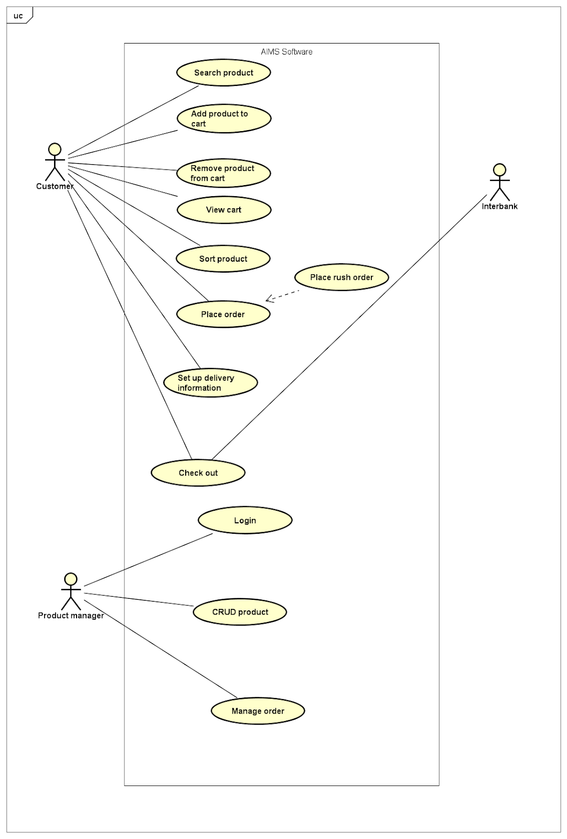
Overall requirements

Slide 10
Assumption/Constraints/Risks
Assumption
The AIMS project, a desktop e-commerce software, operates under several key assumptions:
Compatibility: The software is expected to run on common desktop operating systems like Windows, macOS, and popular Linux distributions, suitable for home and small business hardware.
Internet Dependence: A stable internet connection is required for browsing the catalog and making purchases using VNPay.
User Familiarity: The system is designed for users with some experience in online shopping, offering an intuitive interface similar to common e-commerce platforms.
Content Licensing: All media content available on AIMS is properly licensed from content providers, adhering to licensing and distribution agreements.
Hardware Requirements: The software is assumed to have modest hardware requirements, making it compatible with most consumer-grade desktops and laptops.

Slide 11
Assumption/Constraints/Risks
Constraints
Internet Requirement for VNPay: Users must have an active internet connection to access VNPay functionality.
Product Image Limitations: Users can only select from predefined product images, not upload custom images, to ensure consistency in the user experience.
Risks
Internet Requirement for VNPay: Users must have an active internet connection to access VNPay functionality.
Product Image Limitations: Users can only select from predefined product images, not upload custom images, to ensure consistency in the user experience.

Slide 12
Business Processes
The process of placing an order as a customer
Customer requesting to place an order.
The software then checks if there's enough inventory to fulfill the order.
If sufficient, it prompts the customer to input delivery information, displaying the order details for any necessary adjustments.
Once the customer submits the required information, the software calculates the order details, including the delivery fee and total price.
The customer proceeds to payment, triggering the software to process the transaction and clear the shopping cart for future orders.
The software displays general order information and transaction details.

Slide 13
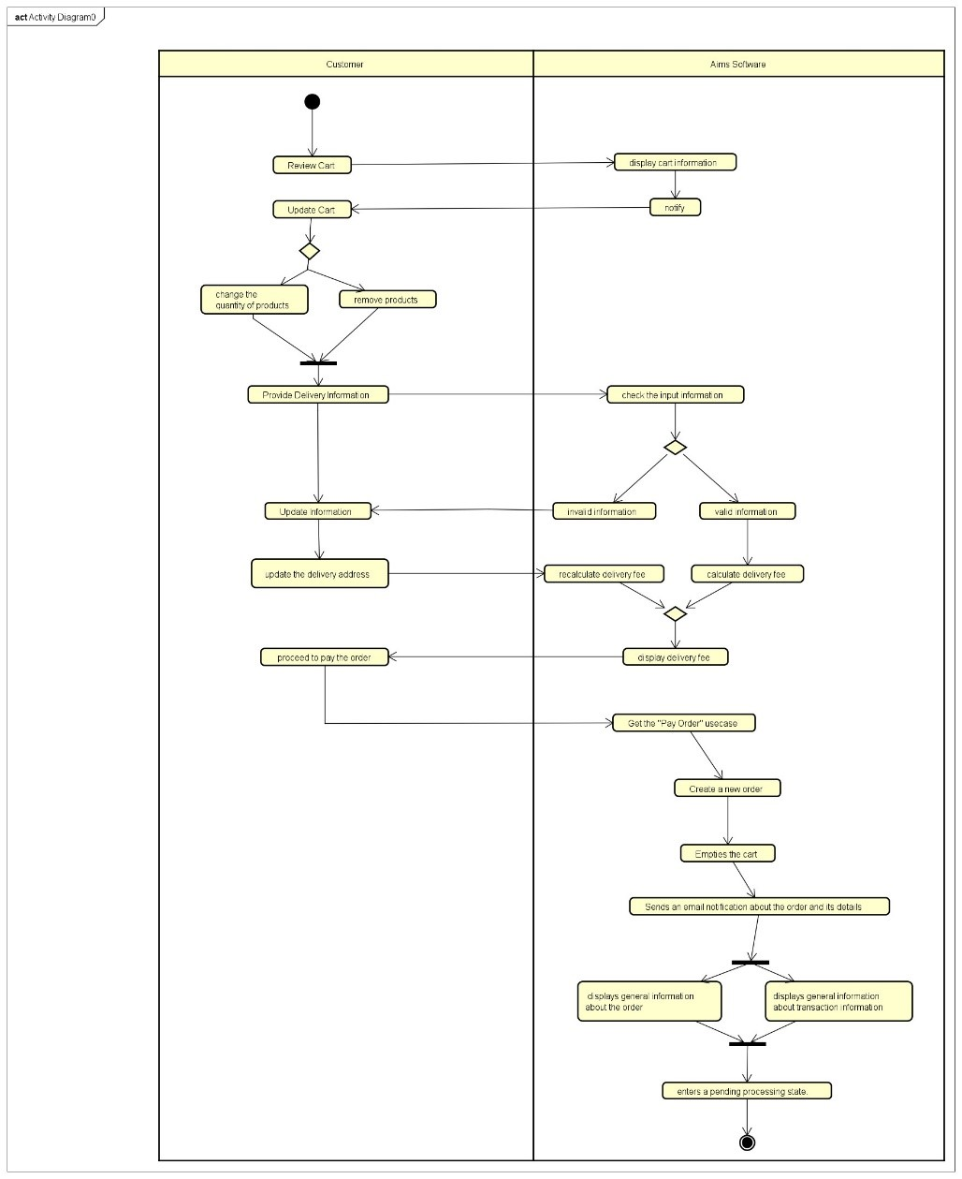
The process of placing an order as a customer

Slide 14
Business Processes
The process of placing rush order as a customer
The software initiates a comprehensive evaluation to determine if the delivery address permits this expedited service and if any products are eligible.
Prompts the customer to ask for supplementary details tailored specifically for rush order fulfillment.
The software discerns which products meet the criteria for expedited delivery, treating those that do not accordingly.
Computes and showcases the order particulars, encompassing the delivery fee and total cost, factoring in any additional charges associated with expedited delivery services.

Slide 15
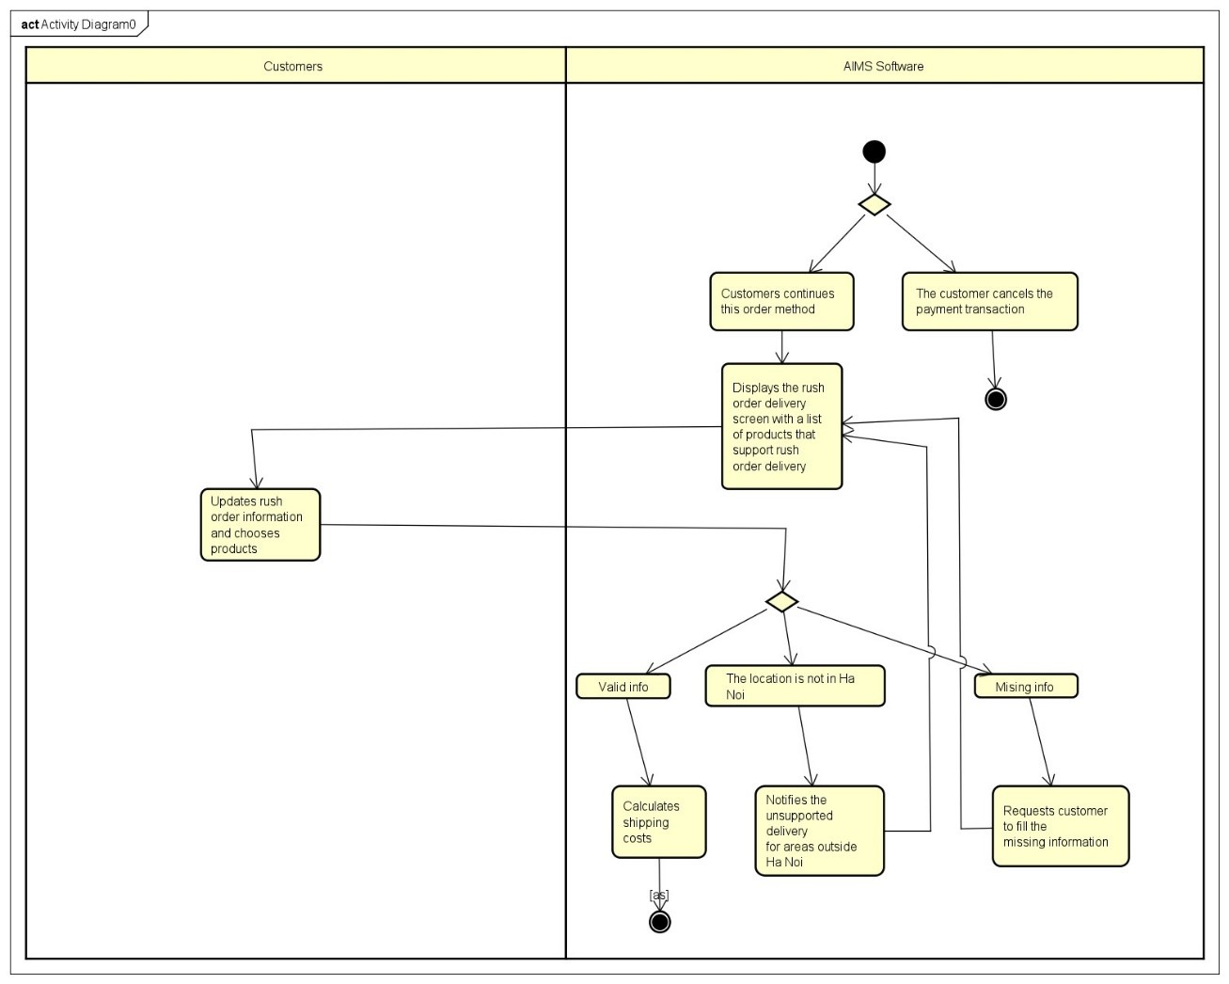
The process of placing an order as a customer

Slide 16
Business Processes
The process of paying for an order as a customer
The software initially records and exhibits the invoice details, comprising a list of products, quantities, total price, delivery fee, and the overall amount due.
The customer opts to settle the invoice.
The software establishes a connection with VNPay, a payment gateway service.
The customer then furnishes and submits the necessary payment information.
VNPay executes the transaction, and upon completion, notifies the software of the transaction outcome.
The software records pertinent transaction information for future reference and auditing purposes.

Slide 17
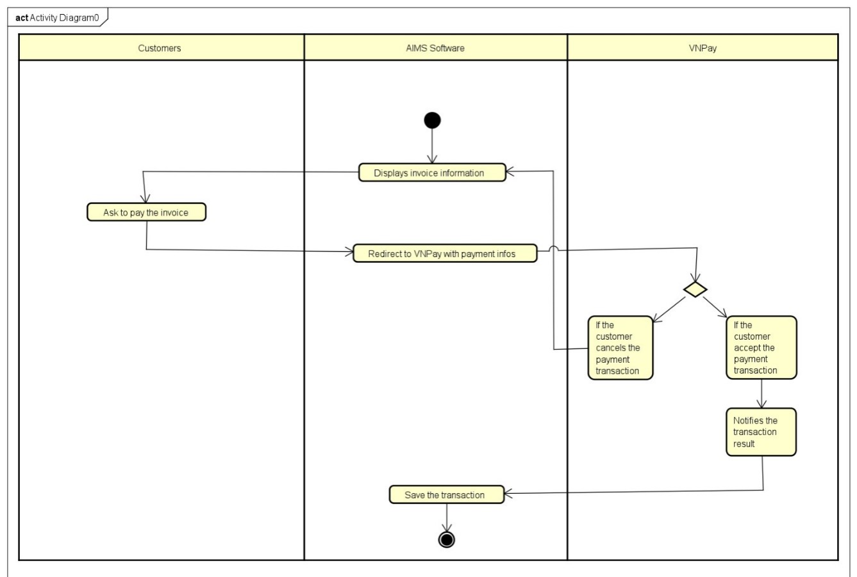
The process of paying for an order as a customer

Slide 18
03
System Architecture and Architecture Design

Slide 19
Architectural Patterns
We used the Entity-Views-Controller (EVC) pattern, a variation of the Model-View-Controller (MVC) pattern. In this pattern:
Entity: Represents the core business logic and data of the application. Entities encapsulate the data and the rules that govern access to and updates of this data. They are similar to the Model in MVC.
Views: Handle the presentation layer of the application. Views are responsible for displaying the data provided by the entities to the user. They ensure that the data is presented in a meaningful way, often formatting or transforming it for display. They are similar to the View in MVC.
Controller: Manages the user input and interactions, updating the entities and views accordingly. Controllers handle the logic that determines how the application responds to user actions, typically by calling methods on entities and updating views. They are similar to the Controller in MVC.

Slide 20
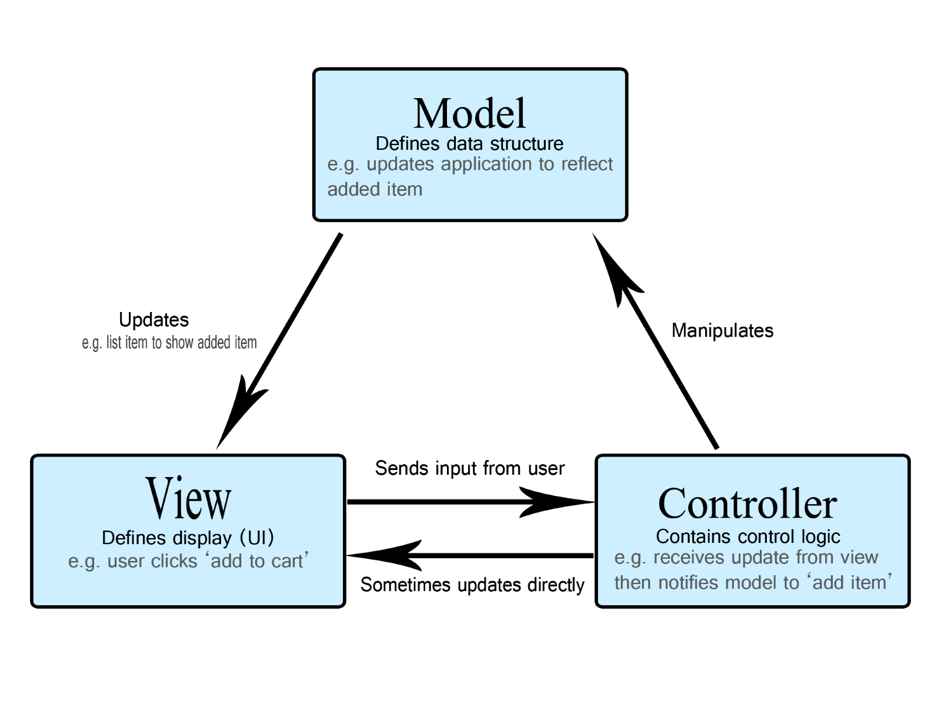
Architectural Patterns

Slide 21
Use case “Place Order”
Brief Description | The use case “Place order” describes the interaction between customers and the AIMS system when the customers wish to request to make a purchase for anything they want which is already included in their carts.
Actors | User
Preconditions | - The cart is not empty (at least 1 item is added to the cart). - The customer reviewed the cart.
Postconditions | -The cart is emptied by the system to prepare for upcoming orders made by the customer. -The transaction and order information are recorded in the system.

Slide 22
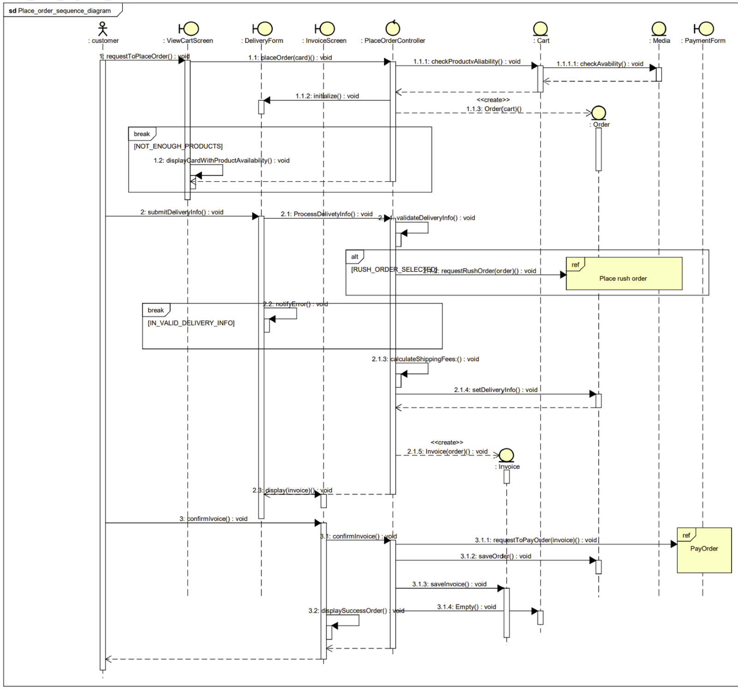
Interaction Diagrams “Place Order”

Slide 23
Use case “Place Order with Place Rush Order”
Brief Description | The use case “Place rush order” describes the interaction between customers and the AIMS system when the customers wish to request to place a rush order.
Actors | User VNPAY
Preconditions | The cart is not empty (at least 1 item is added to the cart). The customer reviewed the cart.
Postconditions | The cart is emptied by the system to prepare for upcoming orders made by the customer. The transaction and order information are recorded in the system.

Slide 24
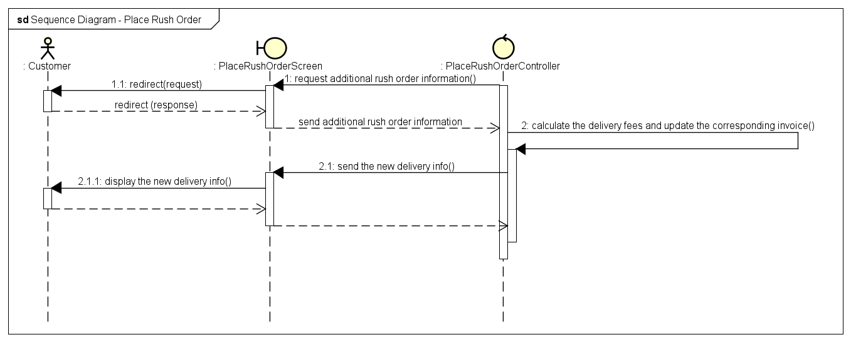
Interaction Diagrams “Place Order with Place Rush Order”

Slide 25
Use case “Pay Order”
Brief Description | The use case “Pay order” describes the interaction between customers and the software with the support of VNPay system to make transactions.
Actors | User VNPAY
Preconditions | - The customer successfully chooses to proceed to pay for the order. - The software has finished calculating the total price including the delivery fee.
Postconditions | The transaction information is recorded successfully in the system.

Slide 26
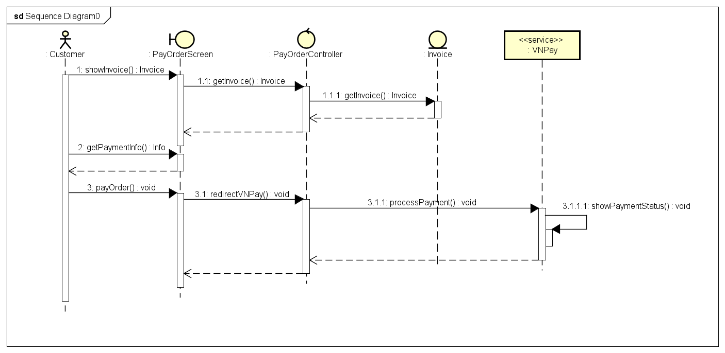
Interaction Diagrams “Pay Order”

Slide 27
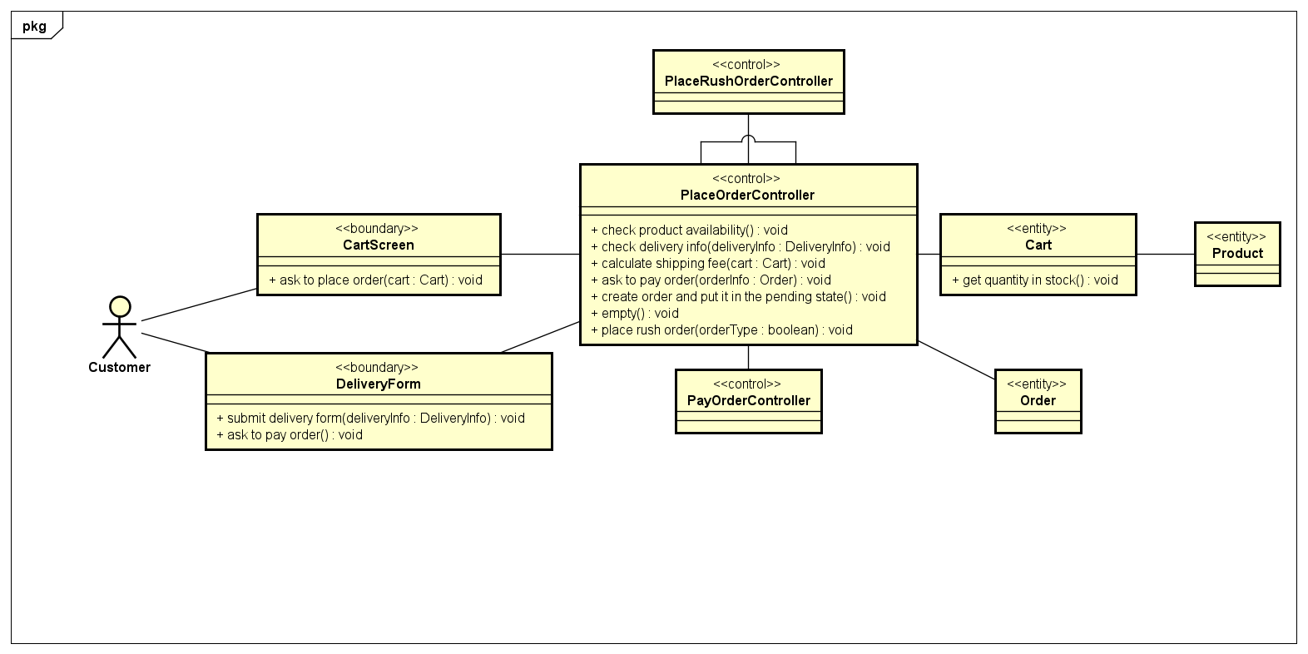
Analysis Class Diagrams “Place Order”

Slide 28
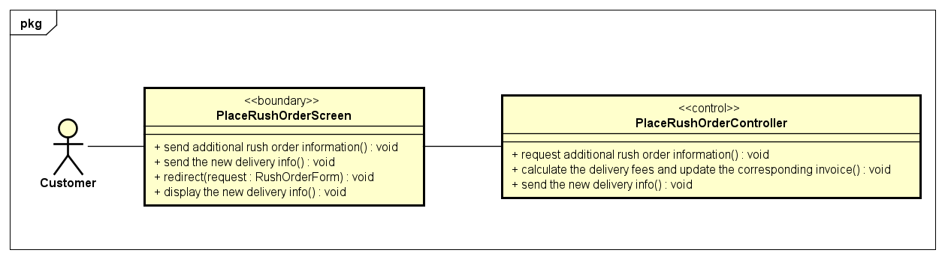
Analysis Class Diagrams “Place Order with Place Rush Order”

Slide 29
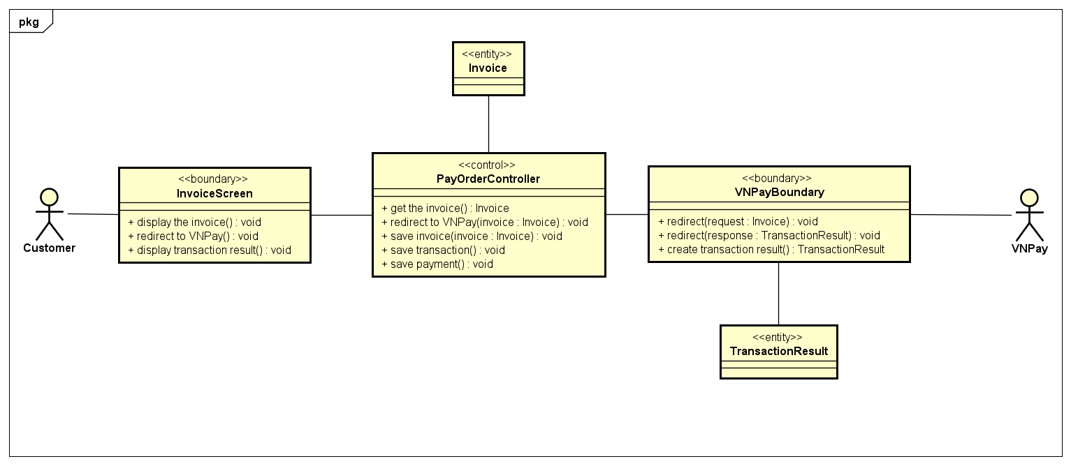
Analysis Class Diagrams “Pay Order”

Slide 30
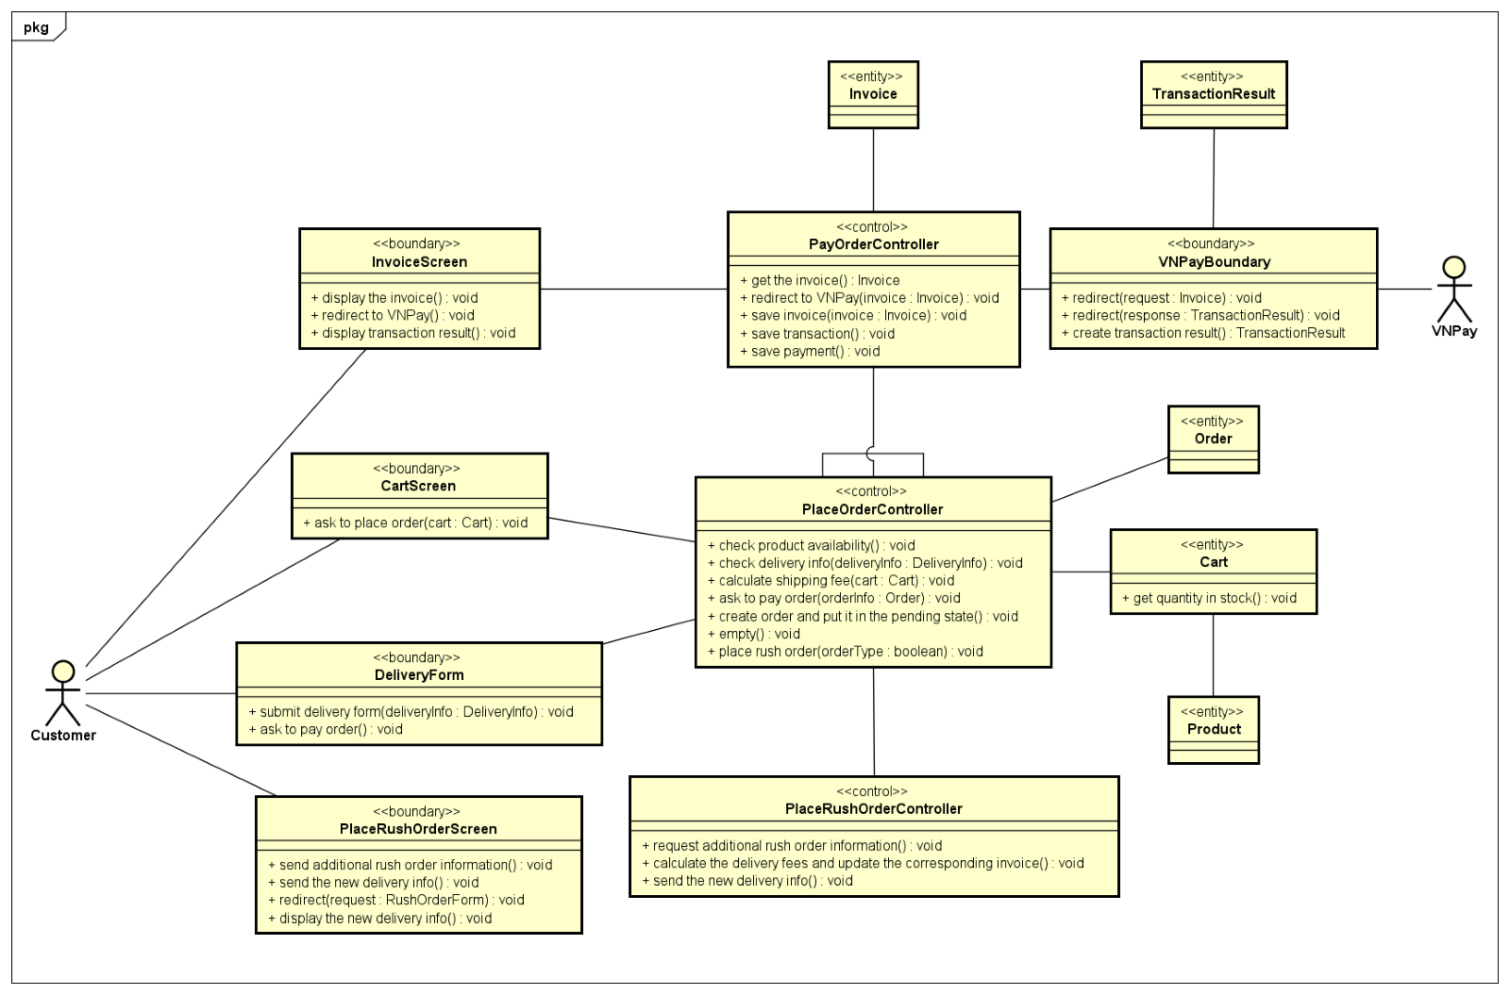
Unified Analysis Class Diagram

Slide 31
Security Software Architecture
Given the scope of the project, a simple login/logout system has been implemented. Below is a detailed description of the security components and configuration:
Authentication:
User Authentication: A basic login system is used to validate user identities before granting access to the system. Users must enter a valid username and password to log in. Passwords are stored securely in the SQLite database to prevent unauthorized access.
Session Management: Upon successful login, a user session is created and maintained until the user logs out. Sessions are managed using unique session IDs to track user activities and ensure that each session is securely maintained.

Slide 32
04
Detailed Design

Slide 33
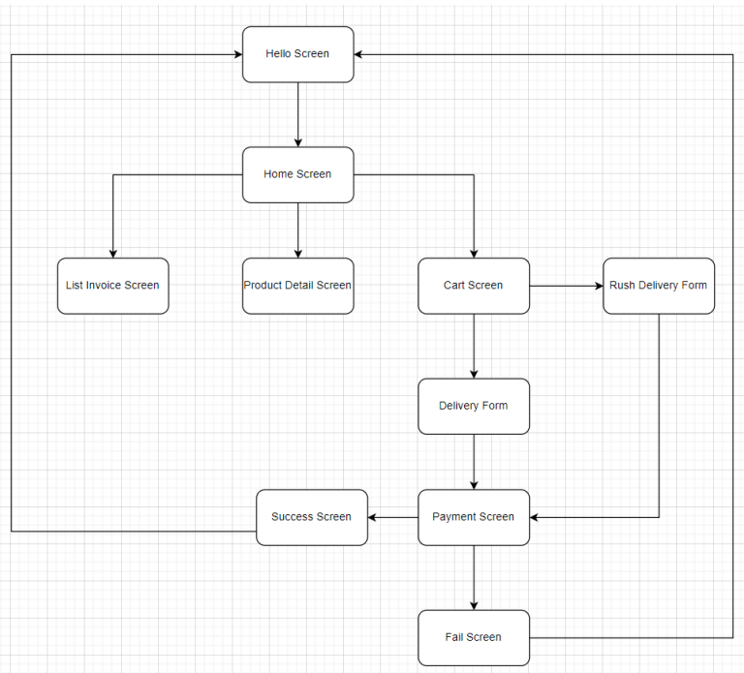
Screen Transition Diagrams

Slide 34
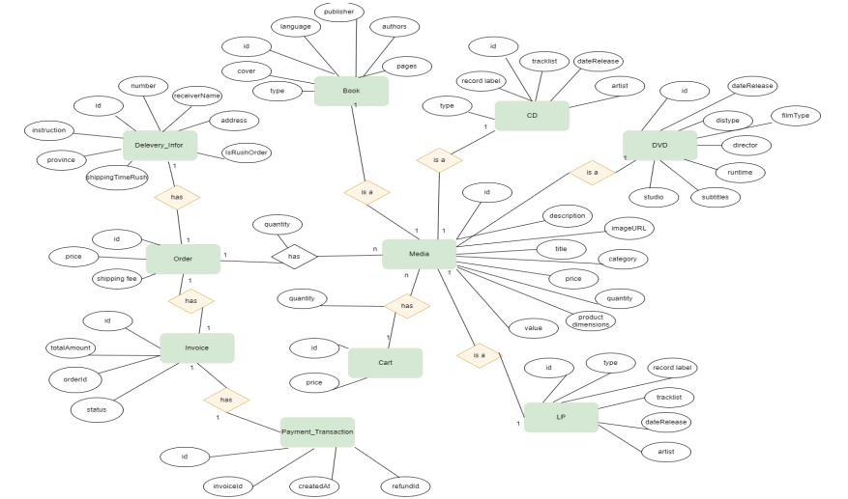
Conceptual Data Modeling

Slide 35
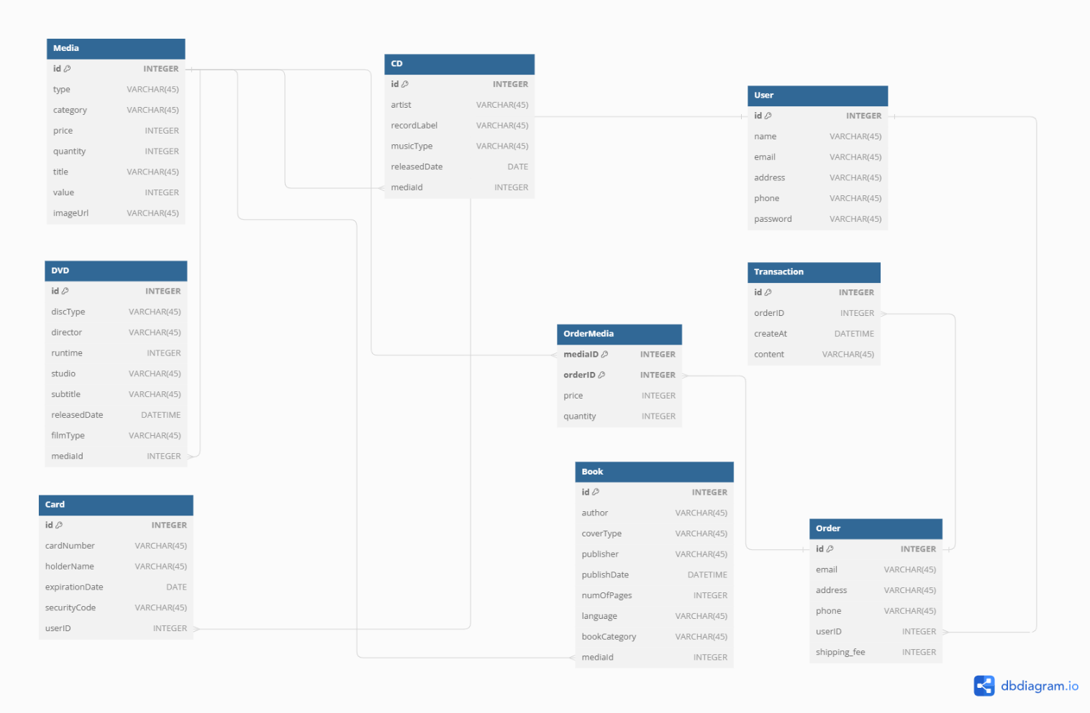
Database Design

Slide 36
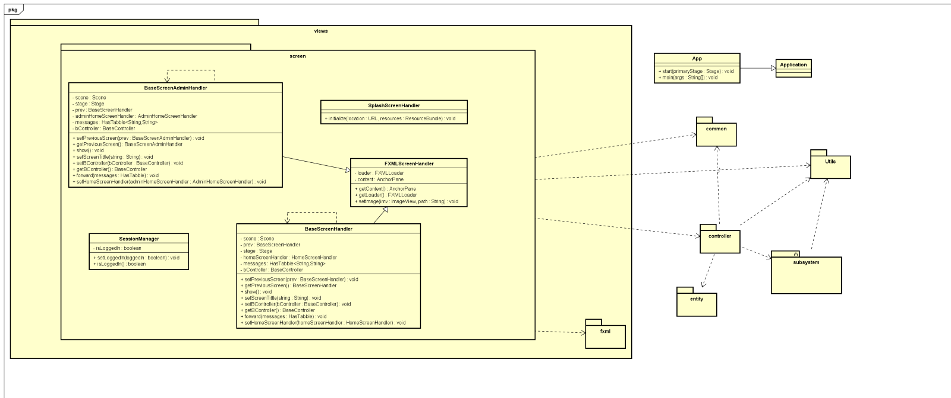
General Class Diagram

Slide 37
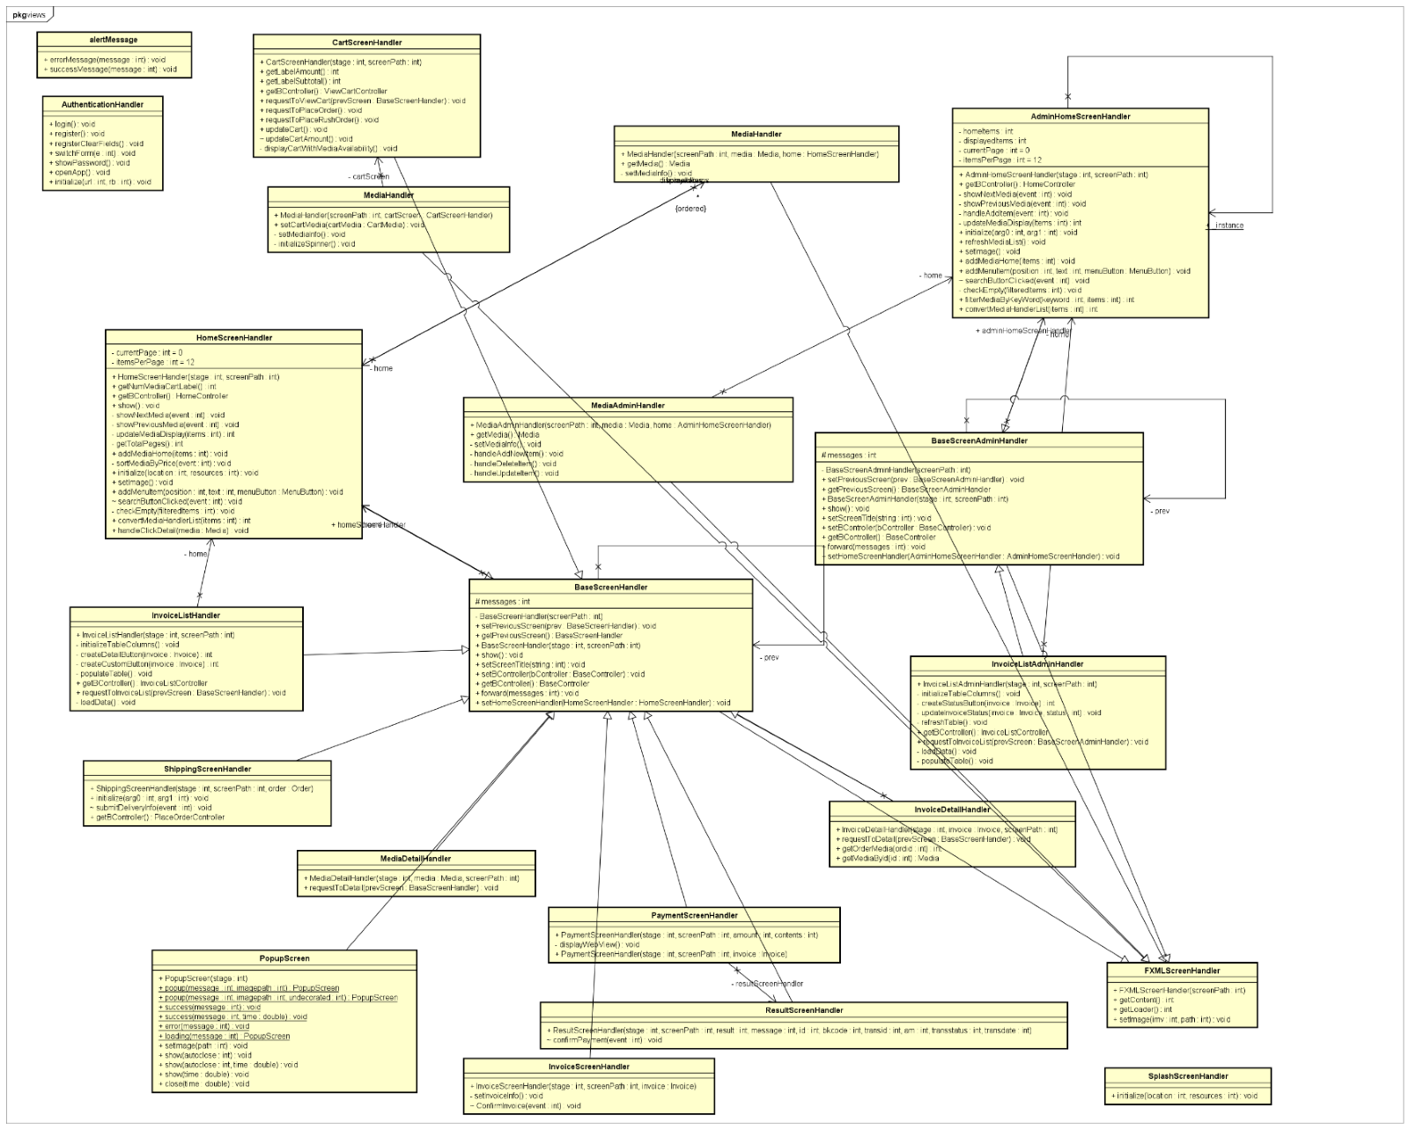
Class Diagram for Package Views

Slide 38
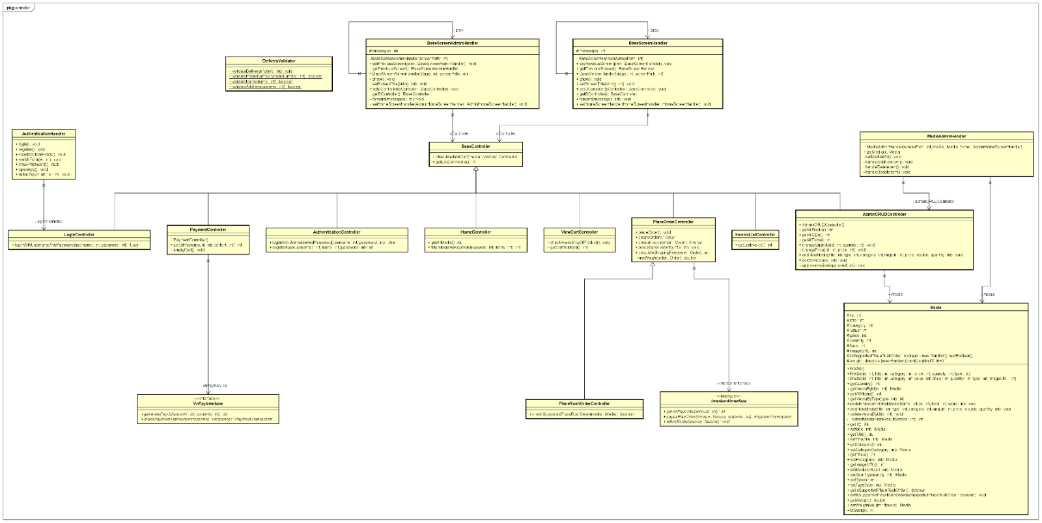
Class Diagram for Package Controller

Slide 39
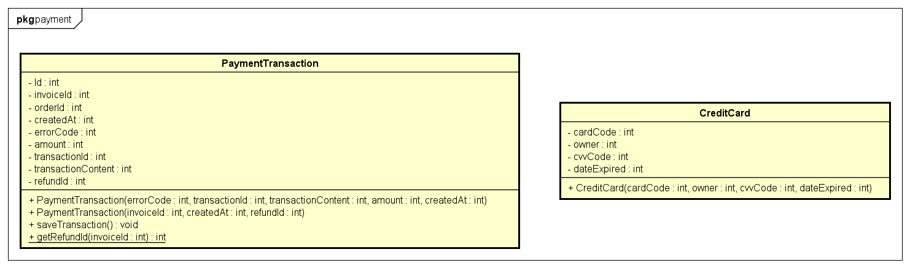
Class Diagram for Package Entity-Payment

Slide 40
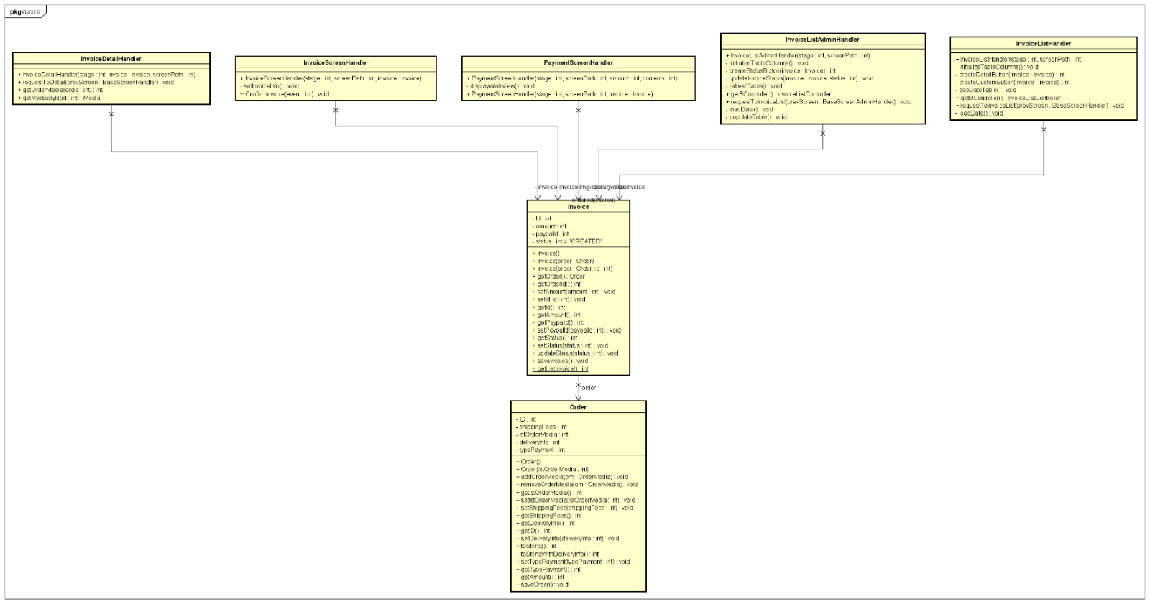
Class Diagram for Package Entity - Invoice

Slide 41
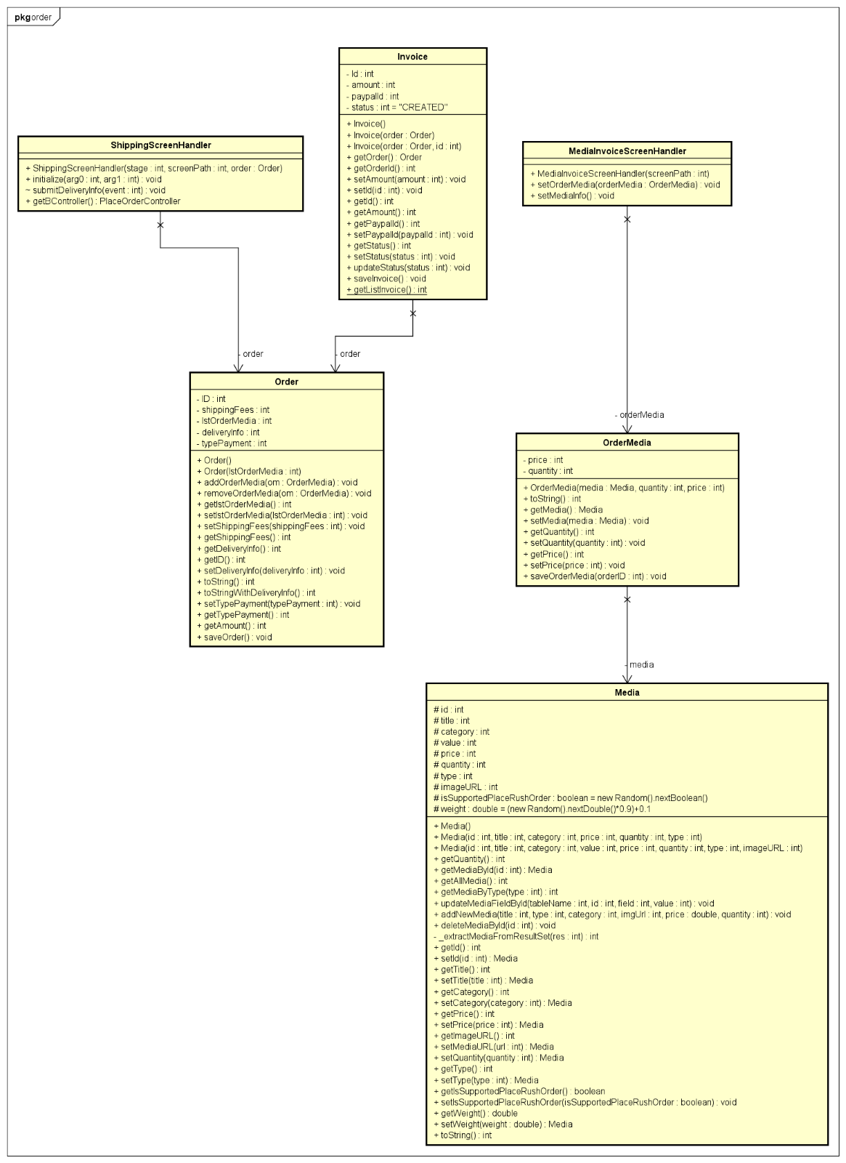
Class Diagram for Package Entity – Order

Slide 42
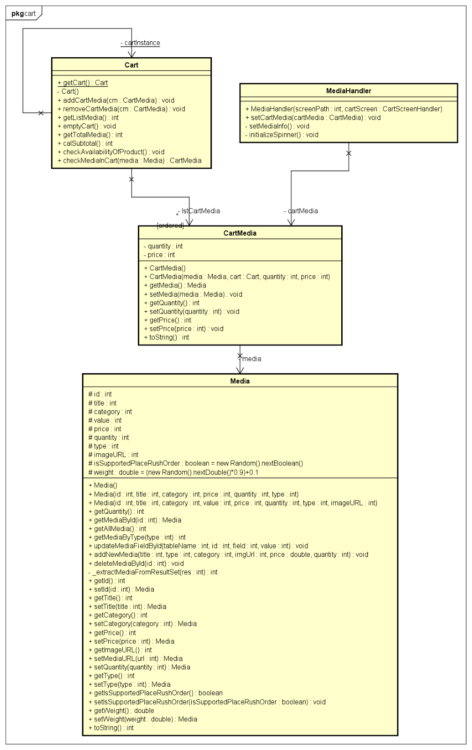
Class Diagram for Package Entity – Cart

Slide 43
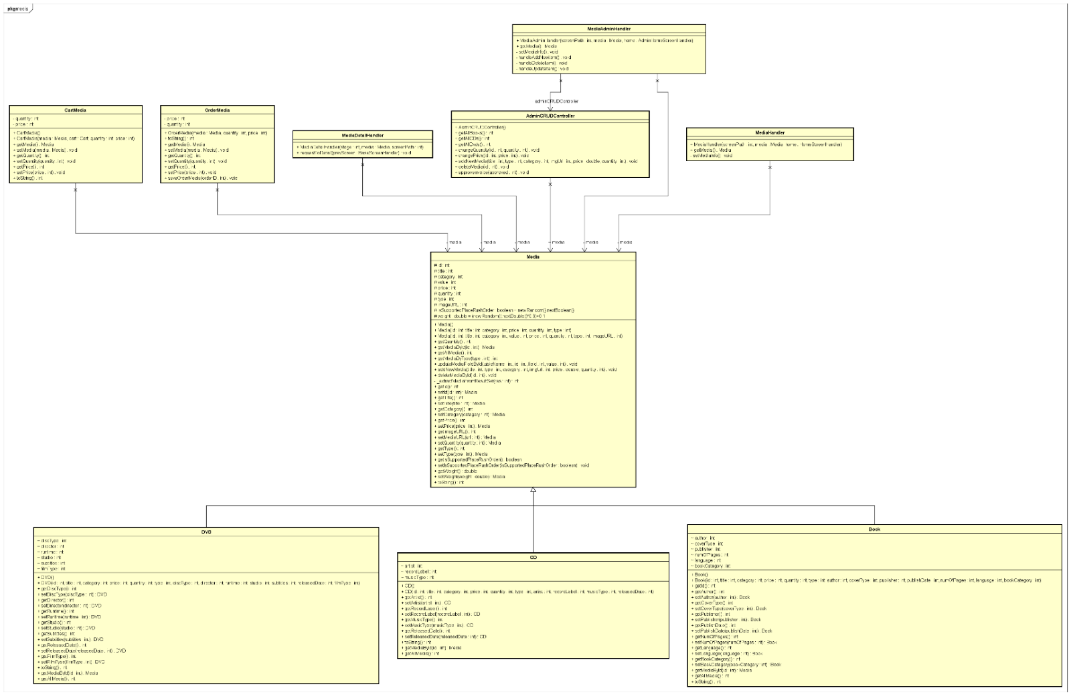
Class Diagram for Package Entity - Media

Slide 44
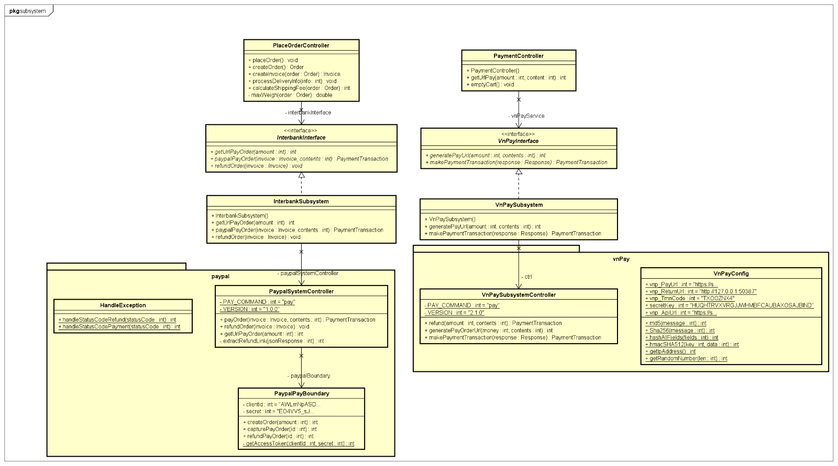
Class Diagram for Package Subsystem

Slide 45
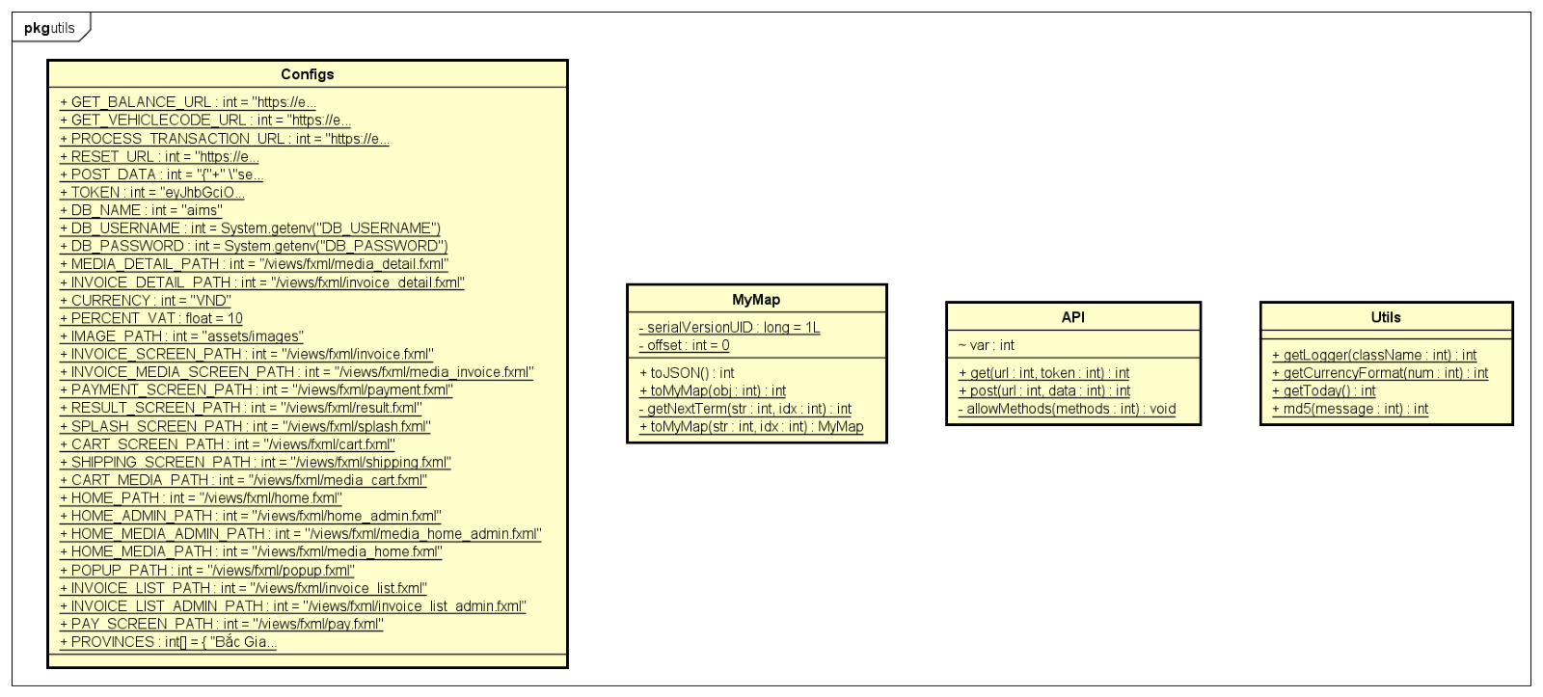
Class Diagram for Package Utlis

Slide 46
05
Design Considerations

Slide 47
Goals and guidelines
Goals
Performance Optimization:
Objective: Enhance the application's speed and responsiveness.
Implementation: Utilize efficient database queries, caching strategies, and minimize data processing and network overhead to ensure quick and smooth operation.
Scalability:
Objective: Develop a modern, easy-to-use interface with JavaFX.
Implementation: Employ a modular architecture and scalable technologies like MySQL and adaptable cloud infrastructure to support growth.
Security and Privacy:
Objective: Protect user data and comply with regulations.
Implementation: Focus on strong authentication and authorization protocols, implement thorough logging, and adopt best practices for data security and privacy.
User-Friendly Interface:
Objective: Provide an intuitive and consistent user experience.
Implementation: Design a clear and navigable interface that enhances ease of use and user satisfaction.

Slide 48
Goals and guidelines
Guidelines
Coding Standards:
Objective: Maintain high code quality and consistency.
Implementation: Adhere to standardized naming conventions, consistent formatting, and thorough documentation to facilitate maintenance and reduce errors.
Modular Design:
Objective: Simplify management, testing, and updates.
Implementation: Structure the application into self-contained modules, allowing for easier handling and modification without impacting the entire system.
Error Handling:
Objective: Ensure the application can handle and recover from errors effectively.
Implementation: Implement robust error handling mechanisms to provide meaningful feedback to users and developers and ensure the system can recover gracefully from issues.

Slide 49
Architectural Strategies
Java and JavaFX for Desktop Application Development:
Java and JavaFX have been selected as the core technologies. Java's platform independence is a significant advantage, ensuring that the application can operate seamlessly across various operating systems such as Windows, macOS, and Linux without requiring any modifications. This capability aligns with the goal of broad accessibility and flexibility for the end-users.
JavaFX complements Java by offering a robust set of tools and UI components designed for creating modern, visually appealing, and responsive user interfaces specifically tailored for desktop environments. JavaFX’s rich set of features, including advanced graphics and media libraries, allows for the development of an engaging and user-friendly interface. This choice ensures that the AIMS application not only functions well but also provides an intuitive and pleasant user experience.

Slide 50
Architectural Strategies
Use of SQLite as the Embedded Database:
SQLite has been selected as the embedded database management system for the AIMS desktop application. Its lightweight nature and efficient performance make it an ideal choice for desktop applications that have moderate data storage and processing needs. SQLite's self-contained and serverless architecture simplifies the integration process and minimizes the application’s footprint, making it a perfect fit for a desktop environment.

Slide 51
Architectural Strategies
Design of Desktop User Interface:
The user interface (UI) design for the AIMS desktop application is centered on enhancing usability and functionality. The design prioritizes clear navigation and the use of intuitive UI components, such as buttons, menus, and toolbars, which facilitate an efficient and user-friendly experience. Each aspect of the UI is structured to support the primary functionalities of the application, including product management, order processing, and user administration.
The UI is designed with a focus on streamlining user interactions and minimizing the learning curve. Consistent design patterns and visual cues are employed to guide users through the application, ensuring that they can perform their tasks efficiently and with ease. The aim is to create a cohesive and visually appealing interface that aligns with the functional requirements of the AIMS application.

Slide 52
Architectural Strategies
Make Use of Github:
GitHub will be utilized as the version control system and collaborative platform for the development of the AIMS desktop application. GitHub provides a comprehensive set of tools that facilitate effective source code management, enabling the team to track changes, manage versions, and collaborate seamlessly.
Using GitHub, the development team can implement a structured workflow, incorporating practices such as branching and merging, to ensure that development progresses smoothly and efficiently. GitHub’s features for issue tracking, project management, and continuous integration further enhance the team's ability to manage the development process, address issues promptly, and maintain a high standard of code quality.

Slide 53
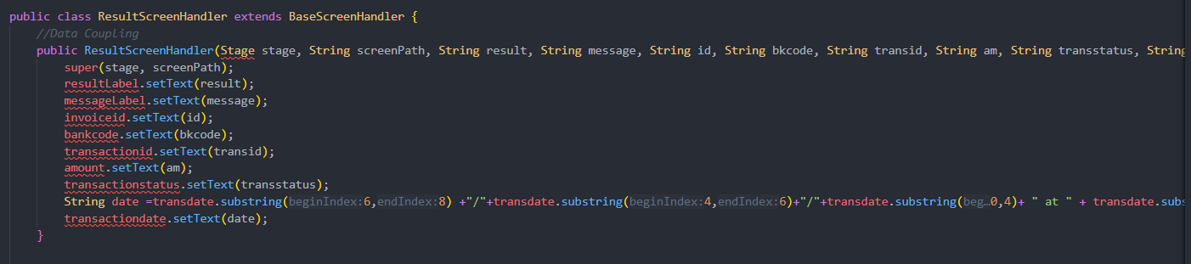
Coupling and Cohesion
Coupling:
The system prioritizes low coupling to enhance modularity and ease of maintenance. It achieves this through a modular architecture that separates the user interface, backend logic, and data persistence into distinct modules. Each module can operate independently, making the system easier to update and manage.

Slide 54
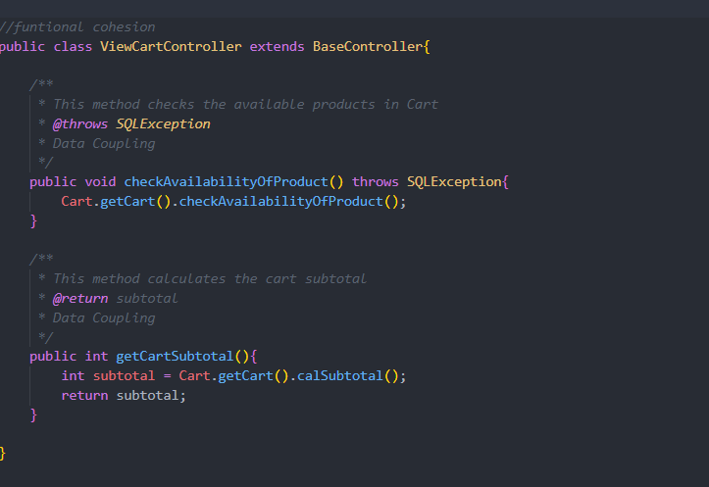
Coupling and Cohesion
Cohesion:
To ensure high cohesion, each component is dedicated to a specific task. This focus improves the readability, maintainability, and reusability of the code. The Single Responsibility Principle is rigorously applied: UI controllers are responsible solely for user interactions, while service classes manage business logic.

Slide 55
Design Principles
Ensuring the SOLID principles in the current design:
Single Responsibility Principle(SRP): A class should have only one reason to change, meaning it should have only one job or responsibility. In the current design, this can be ensured by dividing the application into packages like Controller, View, Entity, and Data Access Layer, so each class has a single responsibility and performs only one specific function.
Open/Closed Principle(OCP): Software entities (classes, modules, functions, etc.) should be open for extension but closed for modification. This means classes should be designed to allow their behavior to be extended without altering their source code, ensuring that new functionality can be added without changing existing code.
Liskov Substitution Principle (LSP): Objects of a superclass should be replaceable with objects of its subclasses without affecting the correctness of the program. Subclasses should override the parent class methods in a way that does not break functionality from a client’s point of view.
Interface Segregation Principle (ISP): Clients should not be forced to depend on interfaces they do not use. This means designing small, specific interfaces rather than large, general-purpose ones, ensuring that implementing classes only need to be concerned with the methods that are of interest to them.
Dependency Inversion Principle (DIP): High-level modules should not depend on low-level modules. Both should depend on abstractions. This principle emphasizes that classes should depend on interfaces or abstract classes rather than concrete classes and functions, promoting loose coupling and enhancing testability and maintainability.

Slide 56
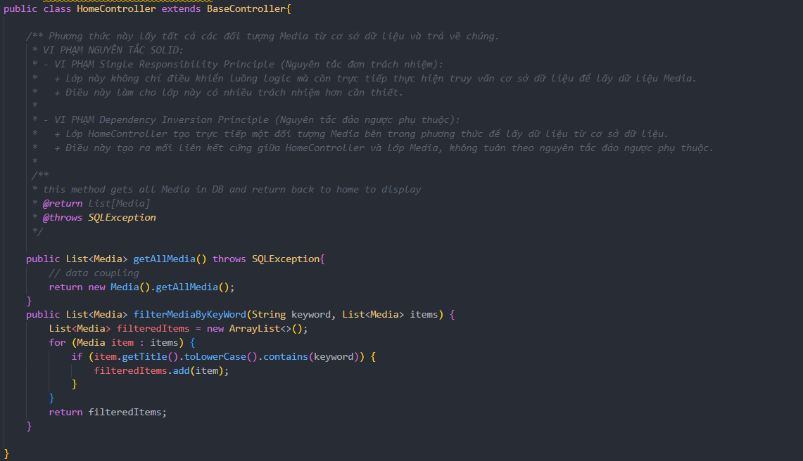
Design Principles
For example, this method retrieves all Media objects from the database and returns them, which creates the violation of SOLID:
VIOLATION OF Single Responsibility Principle (SRP):
This class not only controls the logic flow but also directly performs database queries to retrieve Media data.
This makes the class responsible for more tasks than necessary.
VIOLATION OF Dependency Inversion Principle (DIP):
The HomeController class directly creates a Media object inside the method to retrieve data from the database.
This creates a tight coupling between HomeController and the Media class, which does not adhere to the dependency inversion principle.

Slide 57
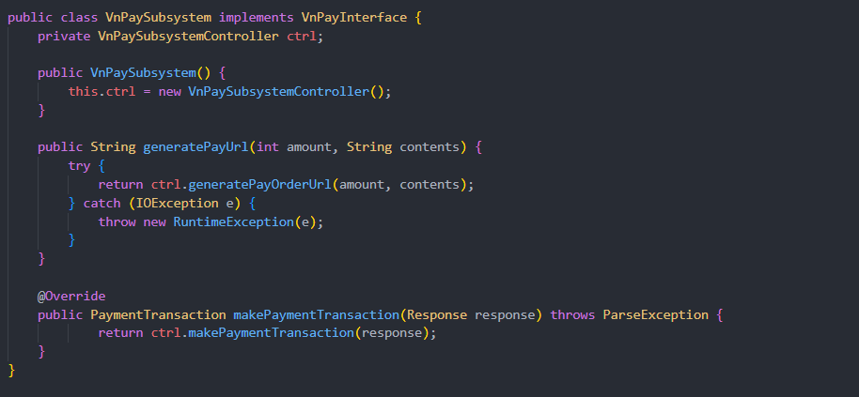
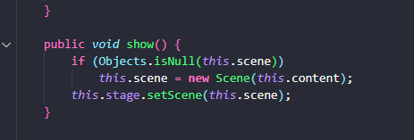
Design Patterns
Strategy pattern:
The Strategy pattern enables a class to execute a task using different algorithms by encapsulating each algorithm in its own separate class.
Singleton pattern:
The Singleton pattern ensures that a class has only one instance and provides a global access point to that instance.
In the BaseScreenHandler class, this pattern is implemented as demonstrated in the function. The class includes a stage attribute to store the screen's stage, initially set to null. This attribute is also marked as private to prevent modification by other classes.

Slide 58
THANKS!

